Slide 1
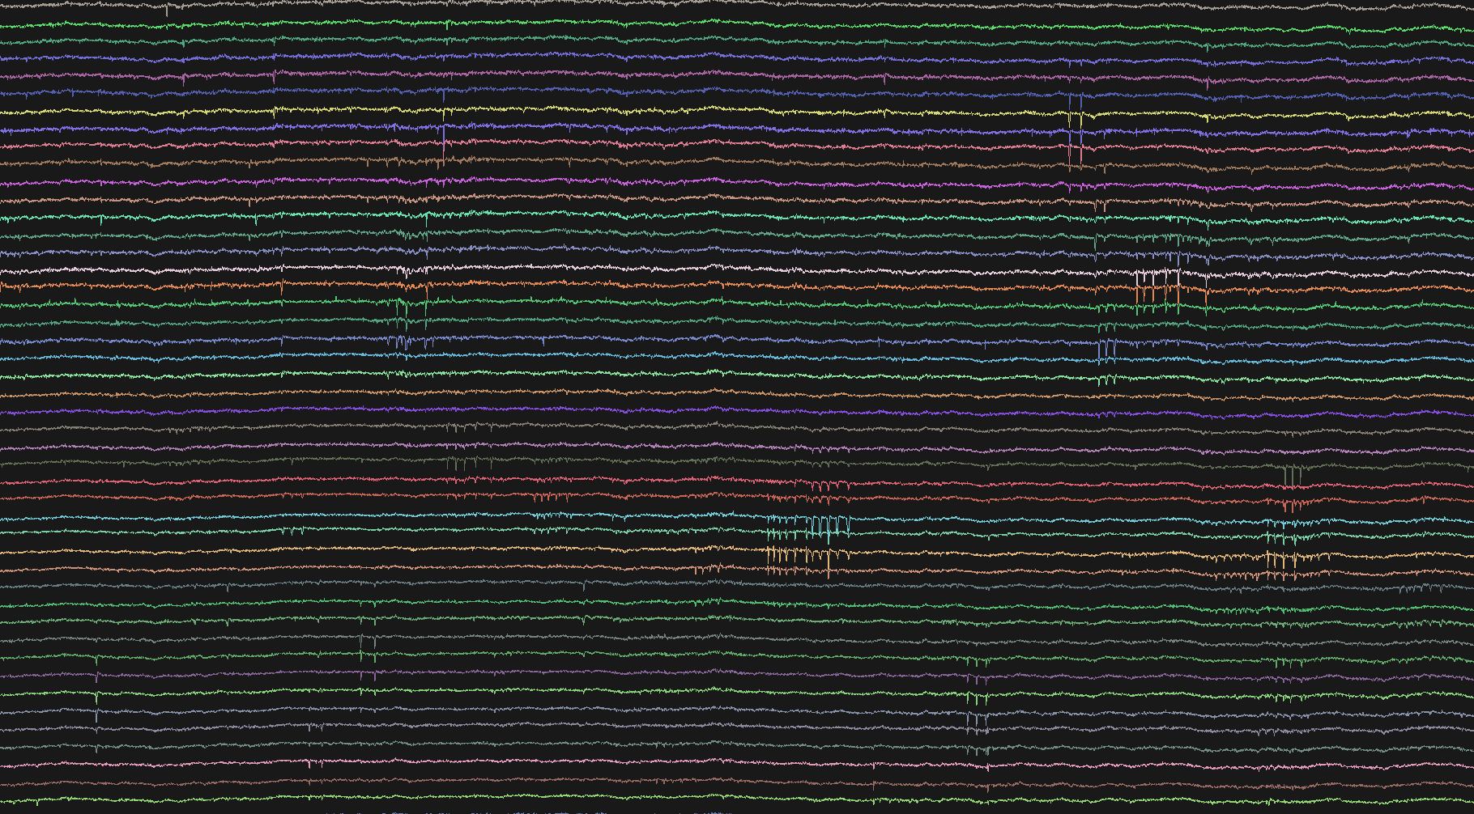
Neuropixels workshop
Paris Neuro course 2019
Optical and electrical recordings in neuroscience

Slide 2
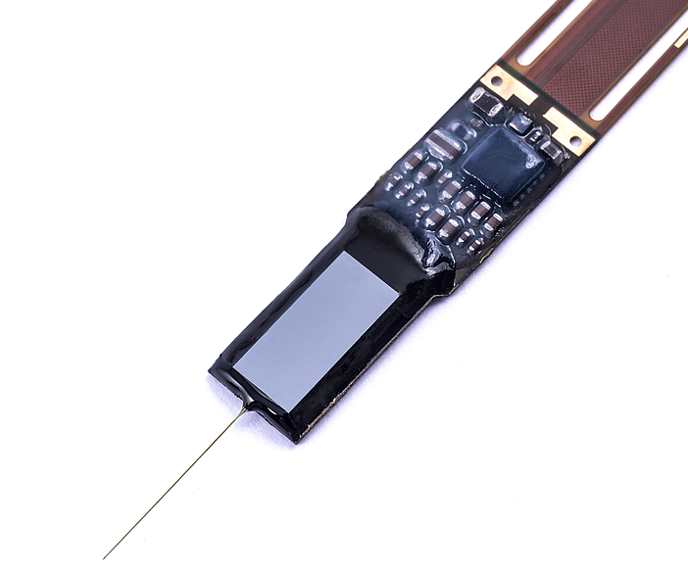
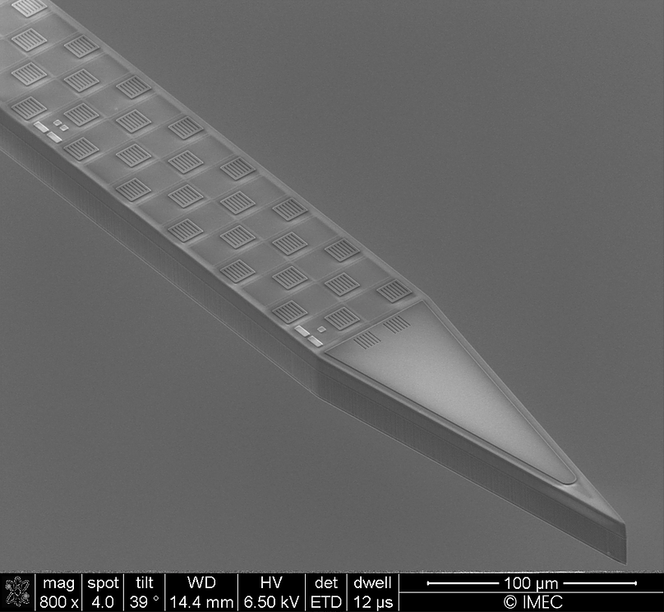
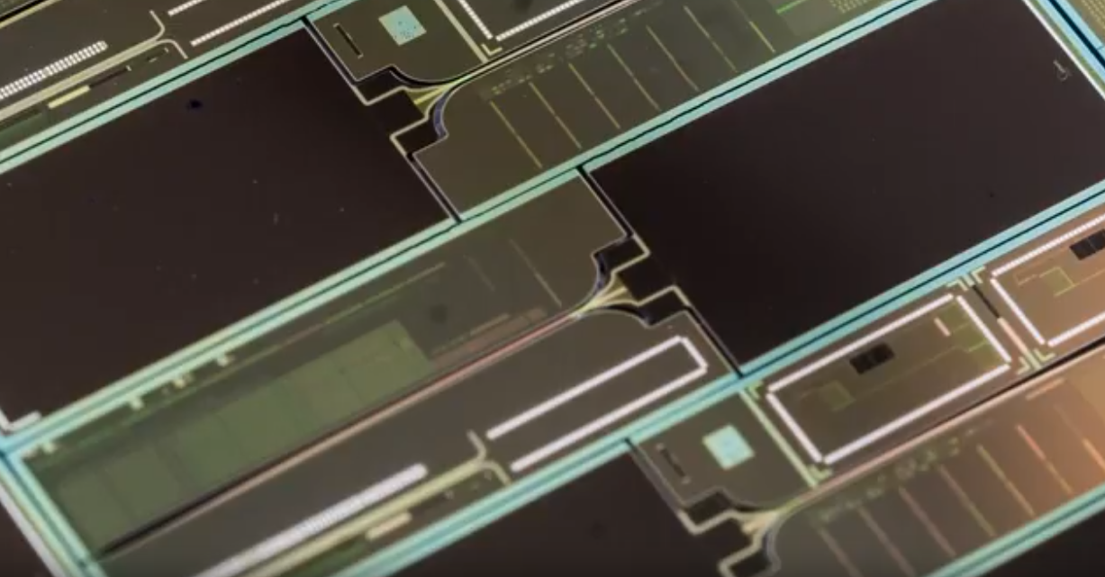
Neuropixels 1.0
Resources:
Get probes and more
https://www.neuropixels.org/
Wiki
https://github.com/cortex-lab/neuropixels/wiki
Slack channel
https://neuropixelsgroup.slack.com
UCL course slides https://www.ucl.ac.uk/neuropixels/courses/2019-course
How to videos:
https://billkarsh.github.io/SpikeGLX/#how-to-videos
IMEC - SEM image of a probe tip and electrodes
IMEC – large scale manufacture

Slide 3
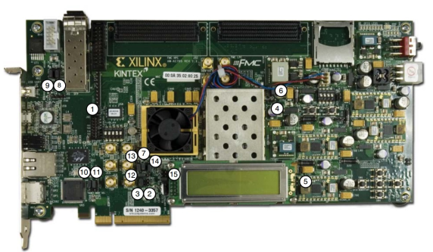
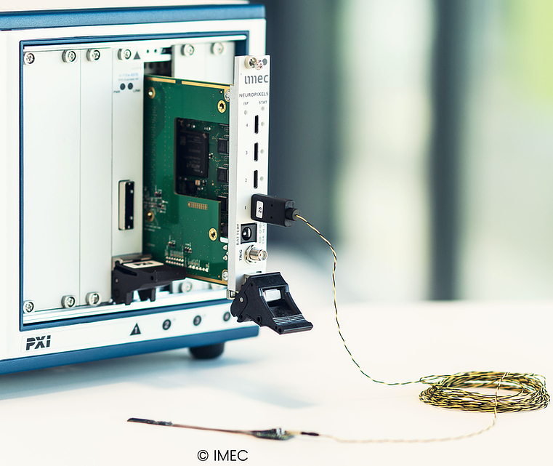
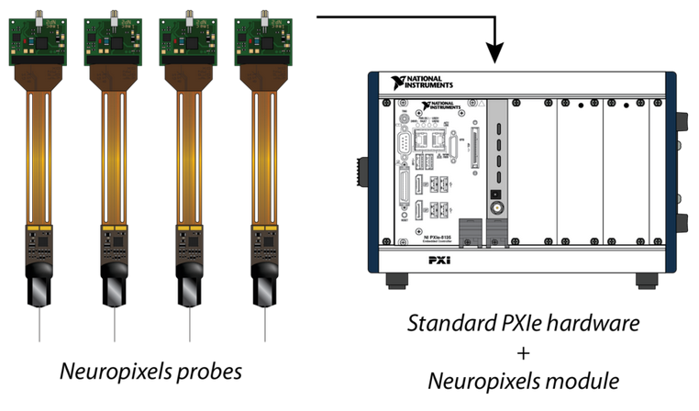
Recording with neuropixels 1.0 probes
Xilinx
1 probe per system; ethernet connection
PXI
4 probes per module; up to 16 per PXI
Image from: http://www.open-ephys.org/neuropixels

Slide 4
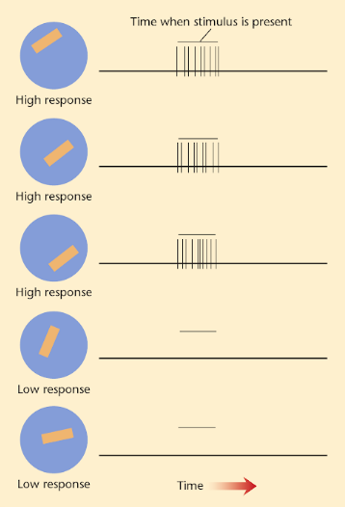
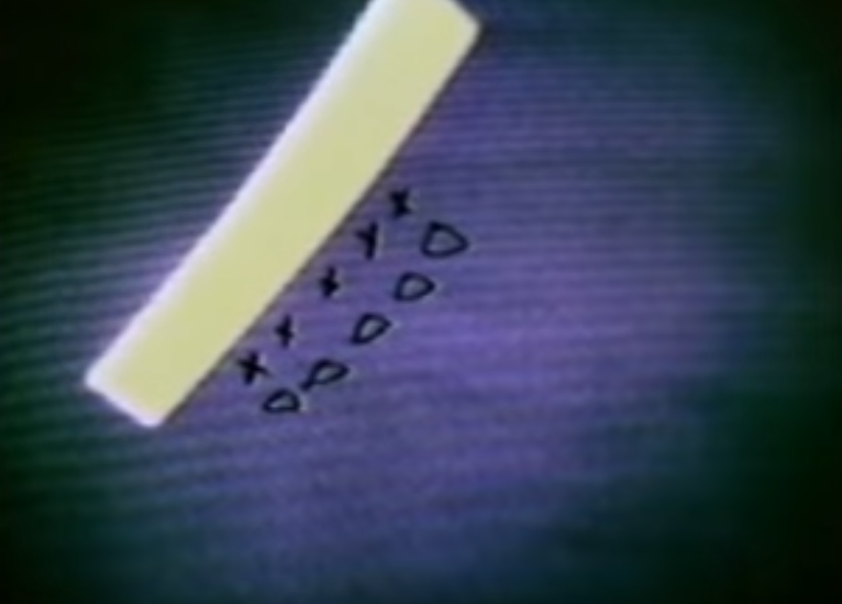
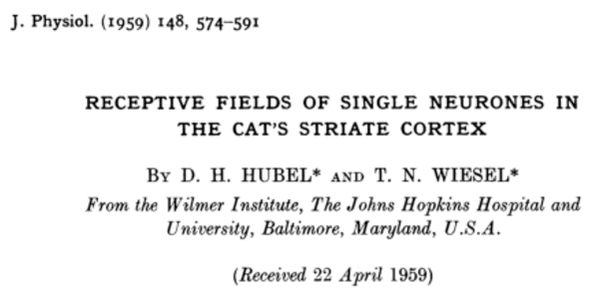
Planning a recording – stimuli
https://www.youtube.com/watch?v=8VdFf3egwfg

Slide 5
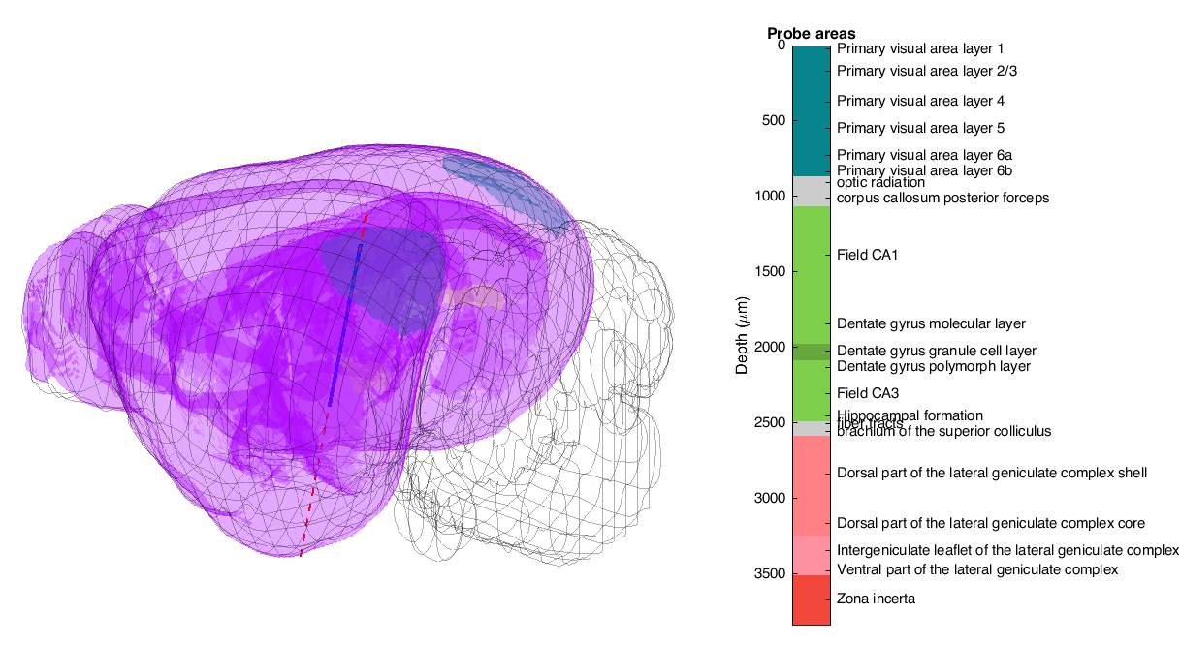
Planning a recording – simultaneous V1 and dLGN
Using the Allen Common Coordinate Framework
Andy Peters https://github.com/cortex-lab/allenCCF
allen_ccf_npx
Probe insertion: -3187 AP, -2400 ML, Angle: 78 deg horizontal

Slide 6
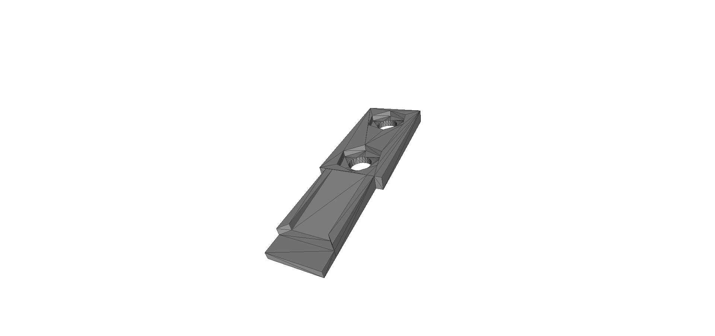
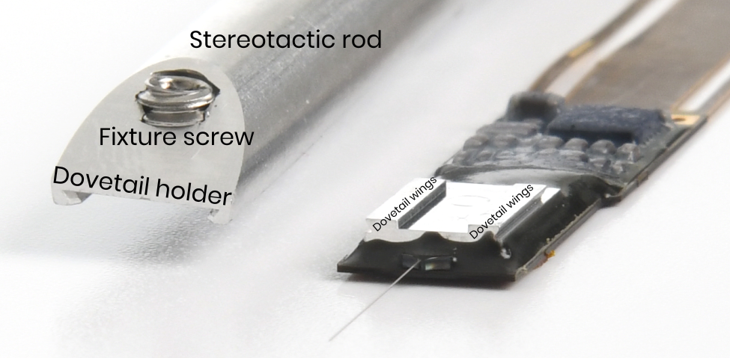
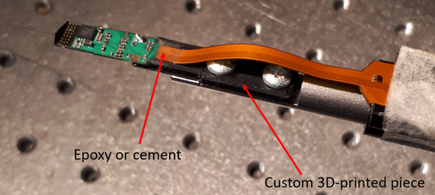
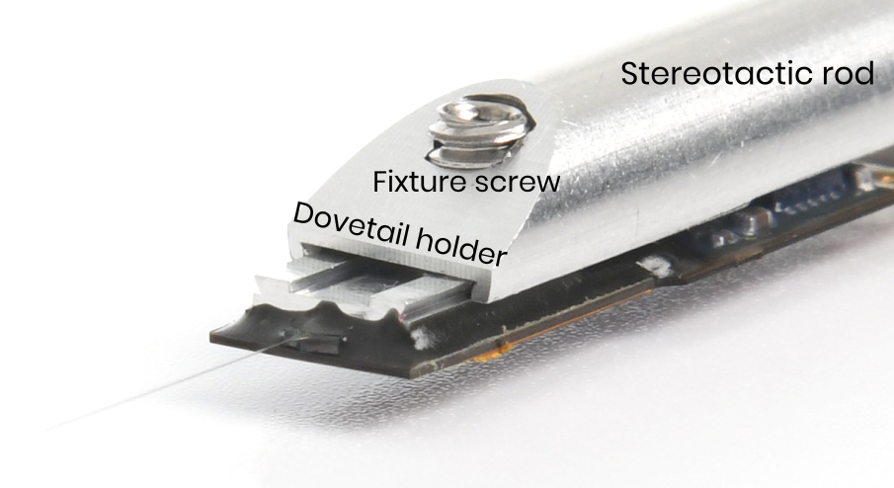
Neuropixels 1.0 – probe holders
3D printed holder
Dovetail holder
Nick Steinmetz
https://github.com/cortex-lab/neuropixels/wiki/Probe_handling
HHMI Janelia
https://flintbox.com/public/project/52167/

Slide 7
Spike sorting - installation
Matlab version | CUDA toolkit
R2019a | 10.0
R2018b | 9.1
R2018a | 9.0
R2017b | 8.0
R2017a | 8.0
R2016 | 7.5
Hardware:
CUDA capable graphics card (4Gb memory)
> 16Gb memory (¼ of the max recording file recomended)
Fast disk - SSD
Software:
CUDA toolkit (depends on matlab version)
Visual Studio Community (on Windows)
Matlab (>R2016)
Toolboxes (check documentation):
Signal Processing
Parallel computing
Statistics and Machine learning
Kilosort2 - https://github.com/MouseLand/Kilosort2
Download: git clone https://github.com/MouseLand/Kilosort2.git
Matlab install: cd CUDA % in the kilosort2 folder
mexGPUall
JRClust - https://github.com/JaneliaSciComp/JRCLUST
Download: git clone https://github.com/JaneliaSciComp/JRCLUST.git
Matlab install: addpath('/path/to/JRCLUST')
jrclust.CUDA.compileCUDA();

Slide 8
Spike sorting – running
Kilosort2 - https://github.com/MouseLand/Kilosort2
With the GUI: kilosort2 https://github.com/MouseLand/Kilosort2/wiki/1.-The-GUI
Through the command line:
1) Create a channelmap: look at \configFiles\createChannelMap.m
2) Copy the master_kilosort.m and configFiles\StandardConfig_MOVEME.m to another folder (e.g. data folder).
3) StandardConfig.m: Set the paths ops.fbinary, ops.fproc, ops.chanMap and ops.root, the sampling frequency – ops.fs, and the number of channels in the file – ops.NchanTOT.
4) master_file.m: Set the paths to the config file and the repositories.
Run the master_file.
JRClust - https://jrclust.readthedocs.io/en/latest/usage/index.html
Create a config file: jrc bootstrap
Display traces: jrc traces <configfile.prm>
Do the sorting: jrc detect-sort <configfile.prm>
Manual sorting GUI: jrc manual <configfile.prm>

Slide 9
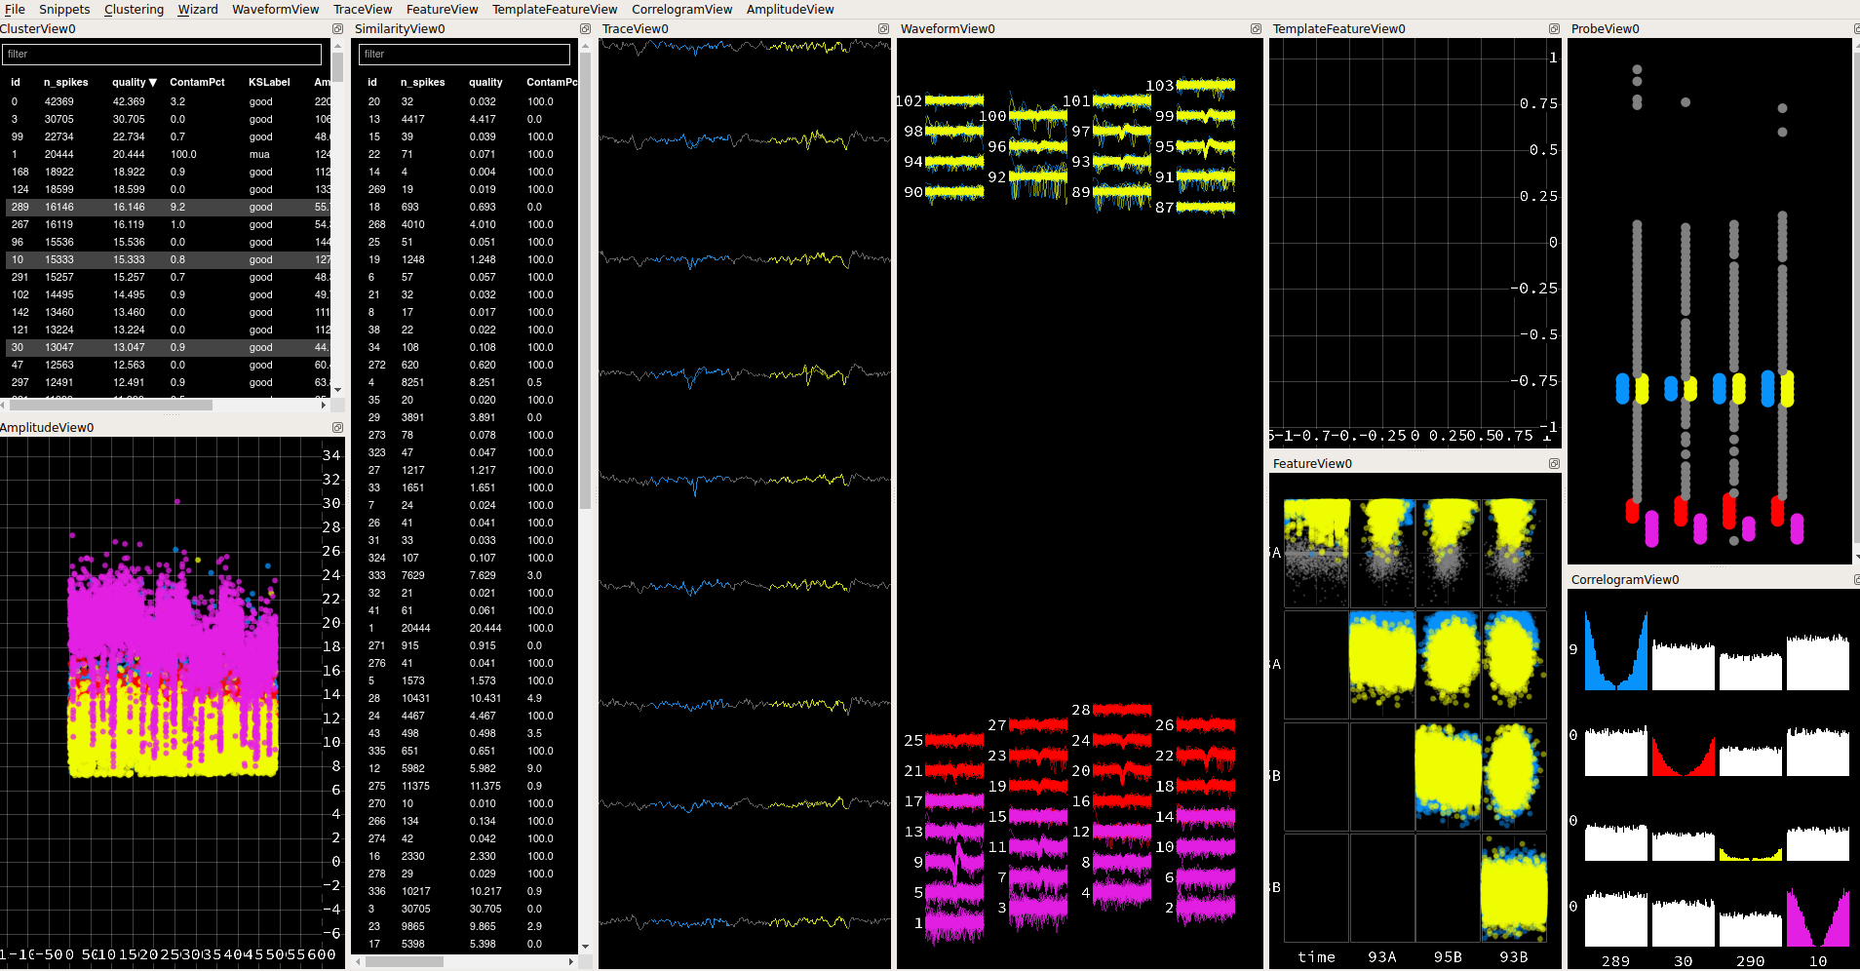
Spike sorting – manual curation kilosort2
Installation:
Install dependencies using conda: https://github.com/kwikteam/phy
pip install git+https://github.com/kwikteam/phy git+https://github.com/kwikteam/phy-contrib --upgrade
Documentation:
https://phy-contrib.readthedocs.io/en/latest/template-gui/ - Important! Has also decision criteria.
Phy template-gui

Slide 10
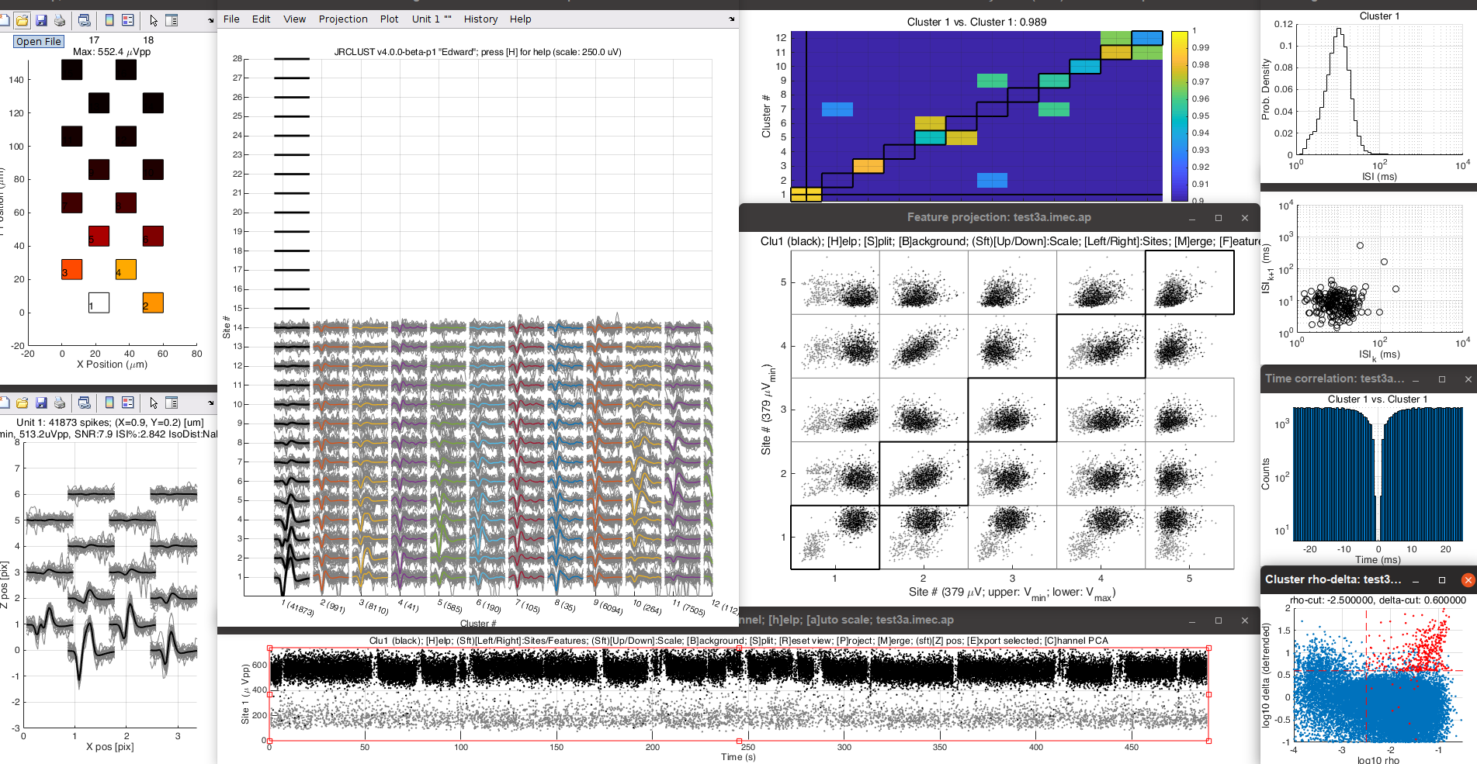
Spike sorting – manual curation JRClust
jrc manual <configfile.prm>
Documentation:
https://jrclust.readthedocs.io/en/latest/pipeline/curate/index.html#the-waveform-view-figwav

Slide 11
Spike sorting – manual curation
Documentation:
https://phy-contrib.readthedocs.io/en/latest/template-gui/#a-typical-approach-to-manual-clustering
Small waveforms?
Yes: label as MUA; move to the next.
No: compare with most similar waveforms.
Are the clusters in different channels?
Yes: Move to the next comparison.
No: inspect cross-correlograms.
Are the autocorrelograms different and there is no refractory period on the cross-correlogram?
Yes: Not the same neuron
No: Check amplitude stability and overlap in feature space
Units drift continuously in time and don’t overlap?
Yes: Probably the same unit, merge.
No: Move to the next comparison.
Clear refractory period and all reasonable comparisons made?
Yes: Classify as “good”
No: Classify as “multi-unit activity” (MUA)

Slide 12
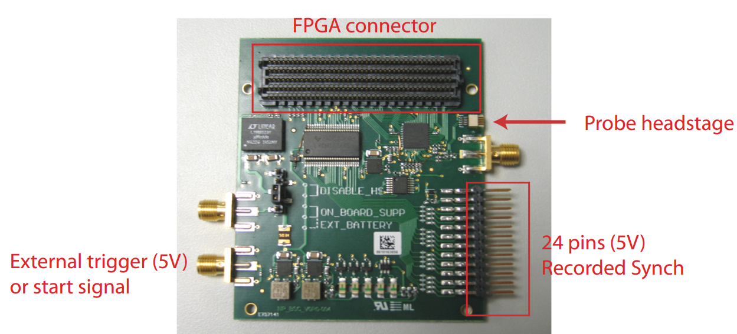
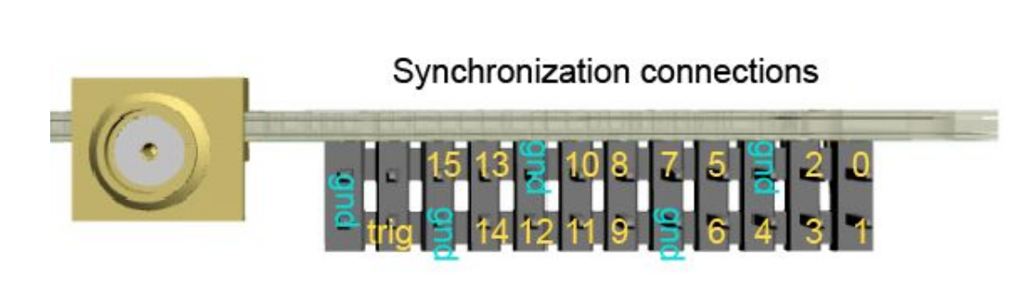
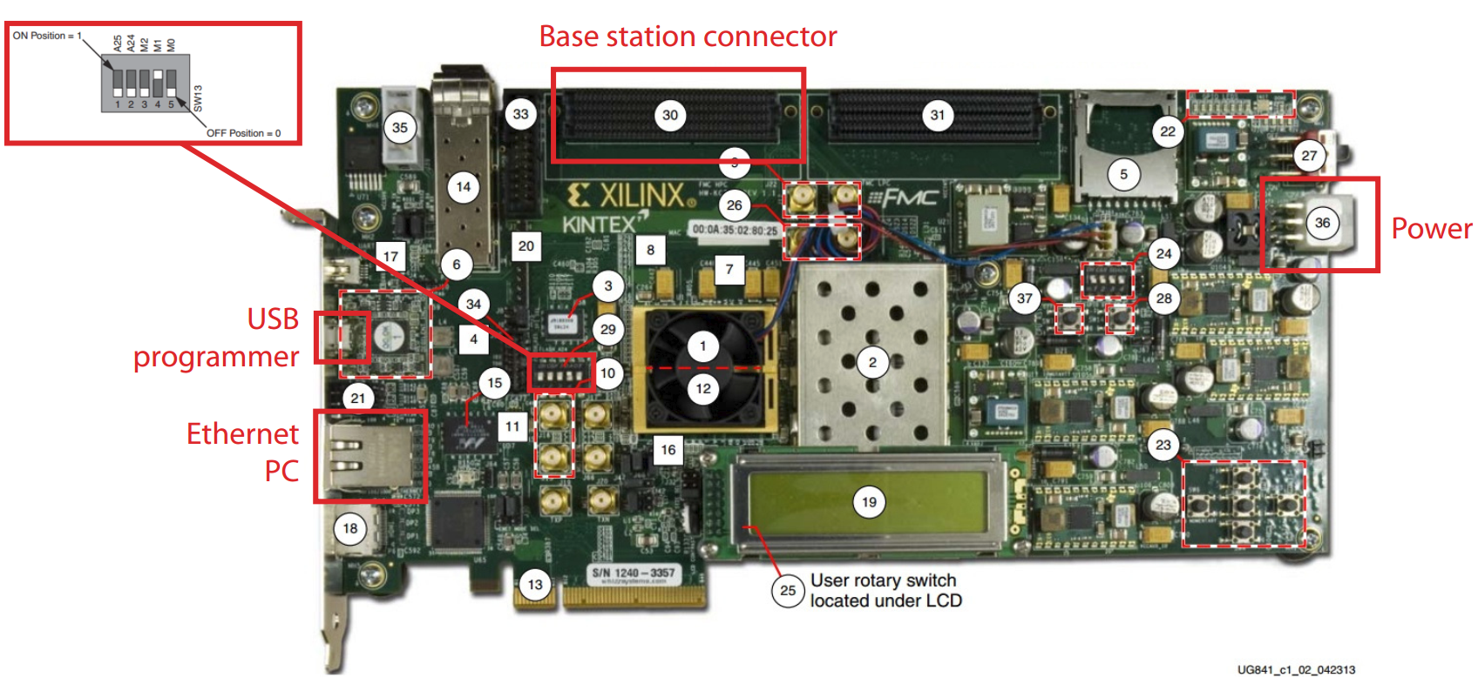
Neuropixels 3A – xilinx and basestation

